Slide 1
Topic 2:
Variables, Design of Programs and Logic (cont.)

Slide 2
Objectives
In this chapter, you will learn about:
Assignment operations
Formatting numbers for program output
Using mathematical library functions
Program input using the cin object
Symbolic constants
Common programming errors
C++ for Engineers and Scientists, Fourth Edition

Slide 3
Assignment Operations
Assignment Statement: Assigns the value of the expression on the right side of the = to the variable on the left side of the =
Another assignment statement using the same variable will overwrite the previous value with the new value
Examples:
slope = 3.7;
slope = 6.28;
C++ for Engineers and Scientists, Fourth Edition

Slide 4
Assignment Operations (continued)
Right side of an assignment statement may contain any expression that can be evaluated to a value
Examples:
newtotal = 18.3 + total;
taxes = .06*amount;
average = sum / items;
Only one variable can be on the left side of an assignment statement
C++ for Engineers and Scientists, Fourth Edition

Slide 5
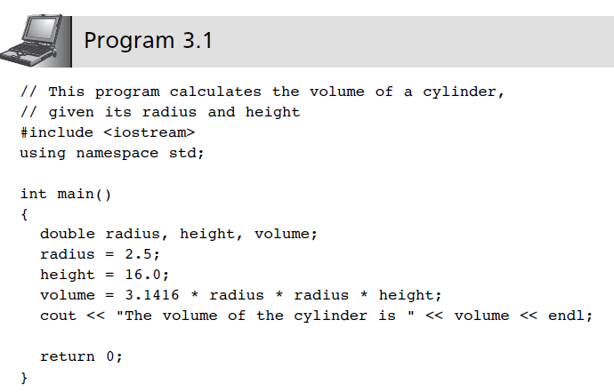
Assignment Operations (continued)
C++ for Engineers and Scientists, Fourth Edition

Slide 6
Assignment Operations (continued)
Assignment operator: The = sign
C++ statement: Any expression terminated by a semicolon
Multiple assignments in the same expression are possible
Example:
a = b = c = 25;
C++ for Engineers and Scientists, Fourth Edition

Slide 7
Assignment Operations (continued)
Coercion: Forcing a data value to another data type
  Value of the expression on the right side of an assignment statement will be coerced (converted) to the data type of the variable on the left side during evaluation
  Variable on the left side may also be used on the right side of an assignment statement
C++ for Engineers and Scientists, Fourth Edition

Slide 8
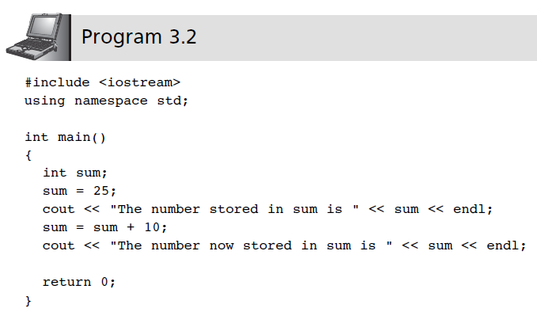
Assignment Operations (continued)
C++ for Engineers and Scientists, Fourth Edition

Slide 9
Assignment Operations (continued)
Accumulation statement: Has the effect of accumulating, or totaling
Syntax:
variable = variable + newValue;
C++ for Engineers and Scientists, Fourth Edition

Slide 10
Assignment Operations (continued)
Additional assignment operators provide short cuts: +=, -=, *=, /=, %=
  Example:
  sum = sum + 10;
  is equivalent to: sum += 10;
  price *= rate +1;
  is equivalent to:
  price = price * (rate + 1);
C++ for Engineers and Scientists, Fourth Edition

Slide 11
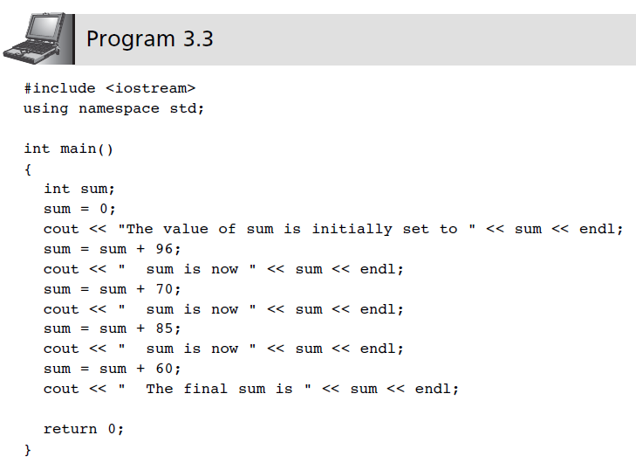
Assignment Operations (continued)
C++ for Engineers and Scientists, Fourth Edition

Slide 12
Assignment Operations (continued)
Counting statement: Adds a fixed value to the variable’s current value
Syntax:
variable = variable + fixedNumber;
Example:
i = i + 1;
count = count + 1;
C++ for Engineers and Scientists, Fourth Edition

Slide 13
Assignment Operations (continued)
Increment operator ++: Unary operator for the special case when a variable is increased by 1
Prefix increment operator appears before the variable
  Example: ++i
Postfix increment operator appears after the variable
  Example: i++
C++ for Engineers and Scientists, Fourth Edition

Slide 14
Assignment Operations (continued)
Example: k = ++n; //prefix increment
is equivalent to:
n = n + 1; //increment n first
k = n; //assign n’s value to k
Example: k = n++; //postfix increment
is equivalent to
k = n; //assign n’s value to k
n = n + 1; //and then increment n
C++ for Engineers and Scientists, Fourth Edition

Slide 15
Assignment Operations (continued)
Decrement operator --: Unary operator for the special case when a variable is decreased by 1
Prefix decrement operator appears before the variable
  Example: --i;
Postfix decrement operator appears after the variable
  Example: i--;
C++ for Engineers and Scientists, Fourth Edition

Slide 16
Formatting Numbers for Program Output
Proper output formatting contributes to ease of use and user satisfaction
cout with stream manipulators can control output formatting
C++ for Engineers and Scientists, Fourth Edition

Slide 17
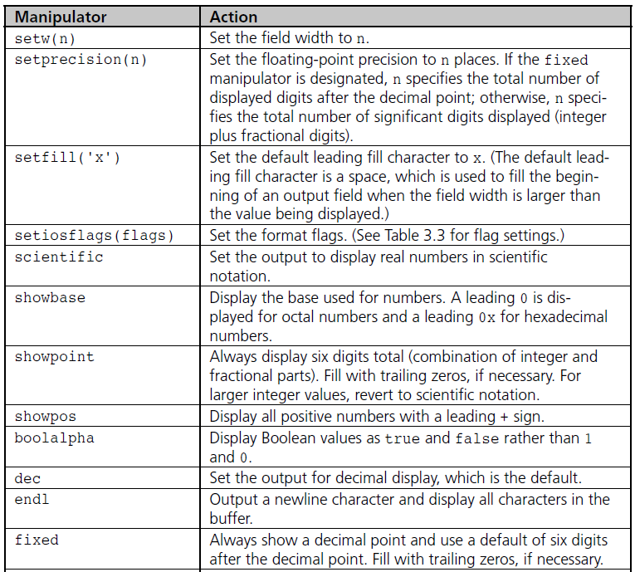
Table 3.1 Commonly Used Stream Manipulators
C++ for Engineers and Scientists, Fourth Edition

Slide 18
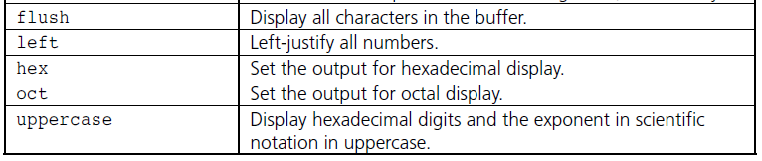
Formatting Numbers for
Program Output (continued)
Table 3.1 Commonly Used Stream Manipulators (continued)
C++ for Engineers and Scientists, Fourth Edition

Slide 19
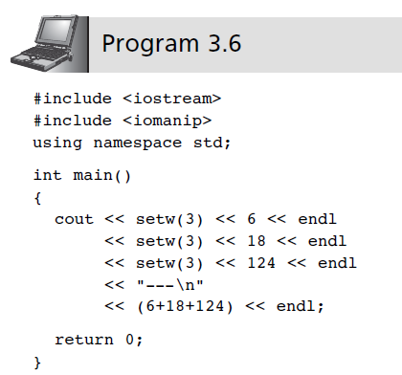
Formatting Numbers for
Program Output (continued)
C++ for Engineers and Scientists, Fourth Edition

Slide 20
Formatting Numbers for
Program Output (continued)
The field width manipulator must be included for each value in the data stream sent to cout
Other manipulators remain in effect until they are changed
iomanip header file must be included to use manipulators requiring arguments
C++ for Engineers and Scientists, Fourth Edition

Slide 21
Formatting Numbers for
Program Output (continued)
Formatting floating-point numbers requires three field-width manipulators to:
  Set the total width of the display
  Force a decimal place
  Set the number of significant digits after the decimal point
Example:
cout << "|" << setw(10) << fixed
<< setprecision(3) << 25.67 << "|";
produces this output: | 25.670|
C++ for Engineers and Scientists, Fourth Edition

Slide 22
Formatting Numbers for
Program Output (continued)
setprecision: Sets number of digits after decimal point if a decimal point has been explicitly forced; otherwise, it sets the total number of displayed digits
If the field width is too small, cout ignores the setw manipulator setting and allocates enough space for printing
If setprecision setting is too small, the fractional part of the value is rounded to the specified number of decimal places
If setprecision value is too large, the fractional value is displayed with its current size
C++ for Engineers and Scientists, Fourth Edition

Slide 23
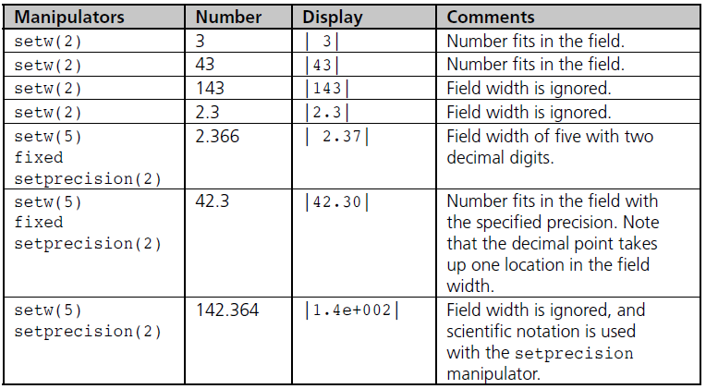
Formatting Numbers for
Program Output (continued)
Table 3.2 Effect of Format Manipulators
C++ for Engineers and Scientists, Fourth Edition

Slide 24
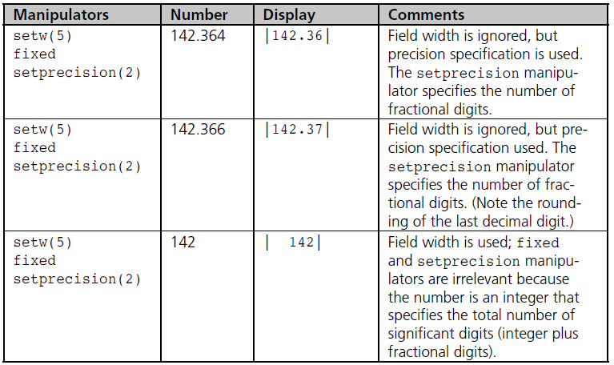
Formatting Numbers for
Program Output (continued)
Table 3.2 Effect of Format Manipulators (continued)
C++ for Engineers and Scientists, Fourth Edition

Slide 25
Formatting Numbers for
Program Output (continued)
setiosflags manipulator: Allows additional formatting:
  Right or left justification
  Fixed display with 6 decimal places
  Scientific notation with exponential display
  Display of a leading + sign
Parameterized manipulator: One which requires arguments, or parameters
C++ for Engineers and Scientists, Fourth Edition

Slide 26
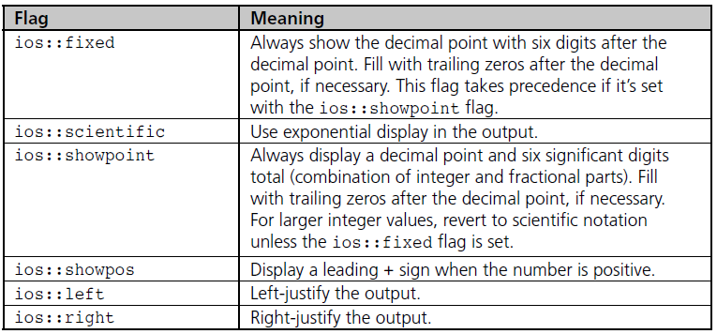
Formatting Numbers for
Program Output (continued)
Table 3.3 Format Flags for Use with setiosflags()
C++ for Engineers and Scientists, Fourth Edition

Slide 27
Using Mathematical Library Functions
C++ has preprogrammed mathematical functions that can be included in a program
You must include the cmath header file:
#include <cmath>
Math functions require one or more arguments as input, but will return only one value
All functions are overloaded, and can be used with integer and real arguments
C++ for Engineers and Scientists, Fourth Edition

Slide 28
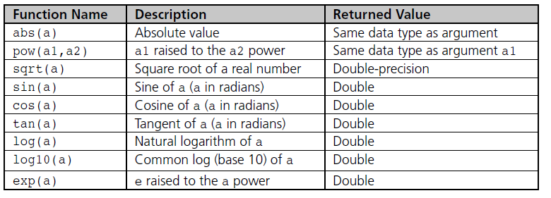
Using Mathematical Library Functions (continued)
Table 3.5 Common C++ Functions
C++ for Engineers and Scientists, Fourth Edition

Slide 29
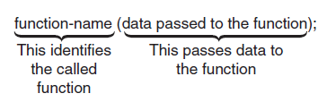
Using Mathematical Library Functions (continued)
To use a math function, give its name and pass the input arguments within parentheses
Expressions that can be evaluated to a value can be passed as arguments
Figure 3.10 Using and passing data to a function
C++ for Engineers and Scientists, Fourth Edition

Slide 30
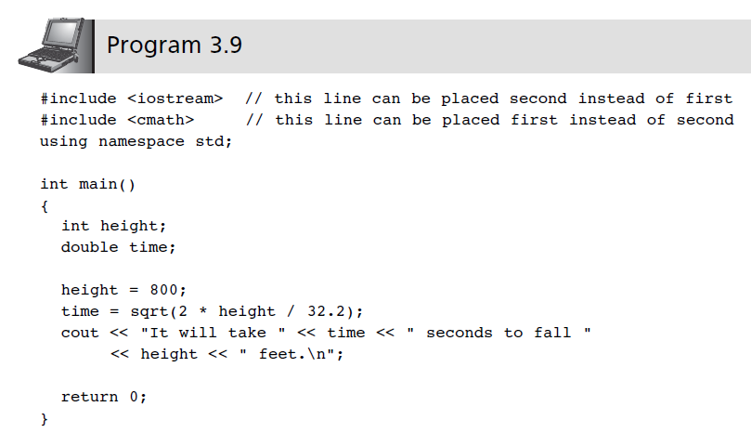
Using Mathematical Library Functions (continued)
C++ for Engineers and Scientists, Fourth Edition

Slide 31
Using Mathematical Library Functions (continued)
Function calls can be nested
  Example: sqrt(sin(abs(theta)))
Cast operator: A unary operator that forces the data to the desired data type
  Syntax: dataType (expression)
  Example: int(a+b)
C++ for Engineers and Scientists, Fourth Edition

Slide 32
Program Input Using cin
cin Object: Allows data entry to a running program
Use of the cin object causes the program to wait for input from the keyboard
When keyboard entry is complete, the program resumes execution, using the entered data
An output statement preceding the cin object statement provides a prompt to the user
C++ for Engineers and Scientists, Fourth Edition

Slide 33
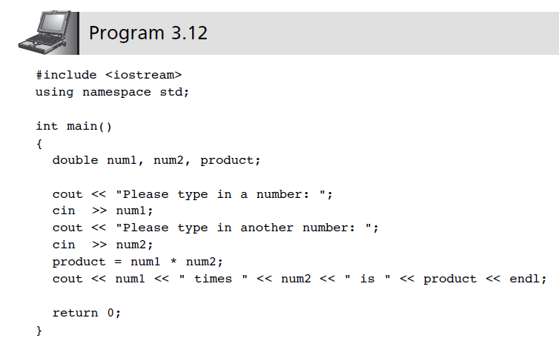
Program Input Using cin (continued)
C++ for Engineers and Scientists, Fourth Edition

Slide 34
Program Input Using cin (continued)
cin can accept multiple input values to be stored in different variables
Multiple numeric input values must be separated by spaces
Example:
cin >> num1 >> num2
with keyboard entry: 0.052 245.79
C++ for Engineers and Scientists, Fourth Edition

Slide 35
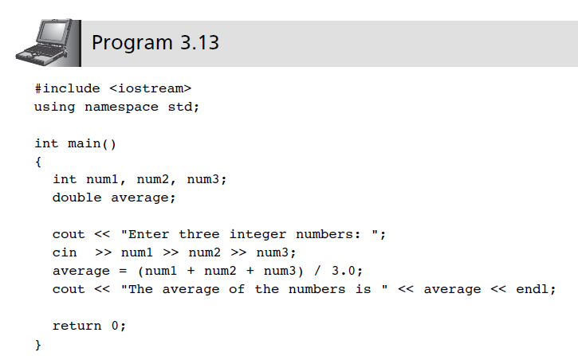
Program Input Using cin (continued)
C++ for Engineers and Scientists, Fourth Edition

Slide 36
Program Input Using cin (continued)
User-input validation: The process of ensuring that data entered by the user matches the expected data type
Robust program: One that detects and handles incorrect user entry
C++ for Engineers and Scientists, Fourth Edition

Slide 37
Symbolic Constants
Symbolic constant: Constant value that is declared with an identifier using the const keyword
A constant’s value may not be changed
Example:
const int MAXNUM = 100;
Good programming places statements in appropriate order
C++ for Engineers and Scientists, Fourth Edition

Slide 38
Symbolic Constants (continued)
Proper placement of statements:
preprocessor directives
int main()
{
symbolic constants
main function declarations
other executable statements
return value
}
C++ for Engineers and Scientists, Fourth Edition

Slide 39
A Closer Look: Programming Errors
Program errors may be detected in four ways:
  Before a program is compiled (desk checking)
  While it is being compiled (compile-time errors)
  While it is being run (run-time errors)
  While examining the output after completion
Errors may be:
  Syntax errors
    typos in the source code
  Logic errors
    often difficult to detect and difficult to find the source
C++ for Engineers and Scientists, Fourth Edition

Slide 40
A Closer Look: Programming Errors (continued)
Program tracing: Stepping through the program by hand or with a trace tool
Debugger: Program that allows the interruption of a running program to determine values of its variables at any point
C++ for Engineers and Scientists, Fourth Edition

Slide 41
Common Programming Errors
Failure to declare or initialize variables before use
Failure to include the preprocessor statement when using a C++ preprogrammed library
Passing the incorrect number or type of arguments to a function
Applying increment or decrement operator to an expression instead of an individual variable
C++ for Engineers and Scientists, Fourth Edition

Slide 42
Common Programming Errors (continued)
Failure to separate all variables passed to cin with the extraction symbol >>
Failure to test thoroughly
Compiler-dependent evaluation when increment or decrement operators are used with variables that appear more than once in the same expression
C++ for Engineers and Scientists, Fourth Edition

Slide 43
Summary
Expression: A sequence of one or more operands separated by operators
Expressions are evaluated based on precedence and associativity
Assignment operator: =
Increment operator: ++
Decrement operator: --
C++ for Engineers and Scientists, Fourth Edition

Slide 44
Summary (continued)
Use #include <cmath> for math functions
Arguments to a function must be passed in the proper number, type, and order
Functions may be included within larger expressions
cin object provides data input from a keyboard; program is suspended until the input arrives
Use a prompt to alert the user to provide input
Constants are named values that do not change
C++ for Engineers and Scientists, Fourth Edition

